Slide 1
Multi-Label Marching Triangles
Misha Kazhdan

Slide 2
Outline
Review
Multi-label segmentation
Extensions to higher dimensions

Slide 3
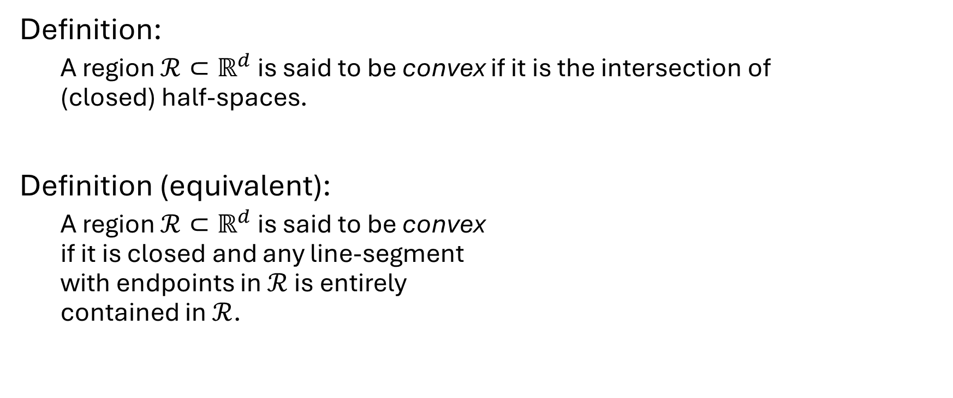

Review: convex spaces in $ℝ^{d}$
Definition:
A region $ℛ⊂ℝ^{d}$ is said to be convex if it is the intersection of (closed) half-spaces.
Definition (equivalent):
A region $ℛ⊂ℝ^{d}$ is said to be convex if it is closed and any line-segment with endpoints in $ℛ$ is entirely contained in $ℛ$.

Slide 4
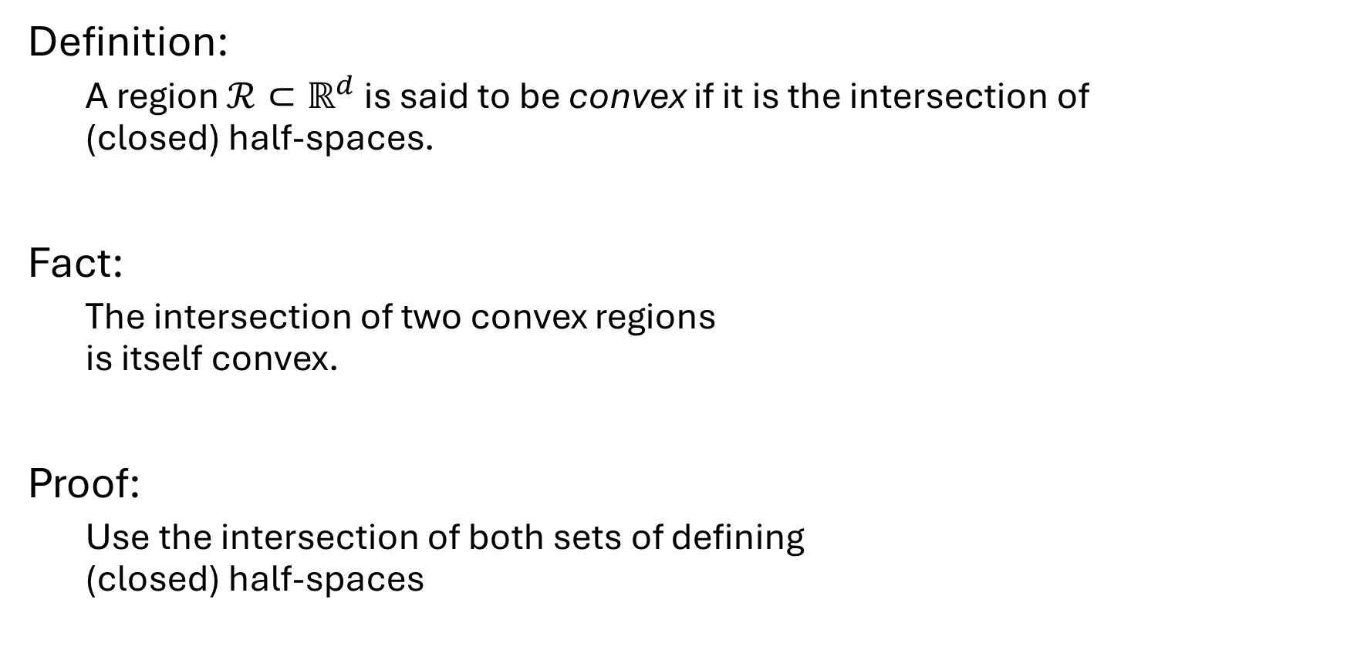
Review: convex spaces in $ℝ^{d}$
Definition:
A region $ℛ⊂ℝ^{d}$ is said to be convex if it is the intersection of (closed) half-spaces.
Fact:
The intersection of two convex regions is itself convex.
Proof:
Use the intersection of both sets of defining (closed) half-spaces

Slide 5

Review: convex spaces in $ℝ^{d}$
Definition:
Given a set of points $P⊂ℝ^{d}$, the convex hull is the smallest convex set containing the points.

Slide 6
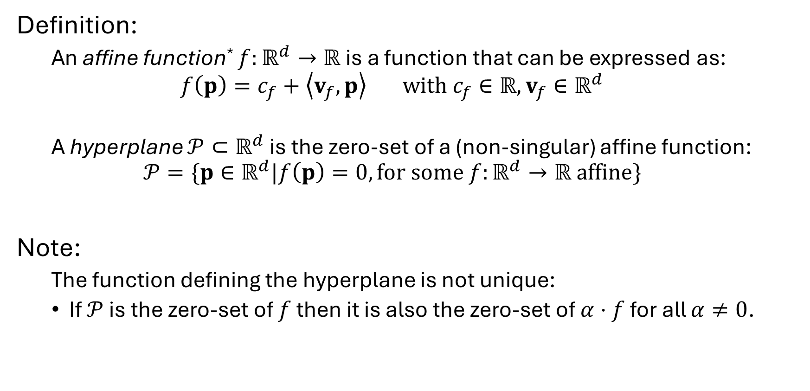

Review: affine functions in $ℝ^{d}$
Definition:
An affine function* $f:ℝ^{d}→ℝ$ is a function that can be expressed as:
$$f\left(p\right)=c_{f}+\left\langle v_{f},p\right\rangle with c_{f}∈ℝ, v_{f}∈ℝ^{d}$$
A hyperplane $𝒫⊂ℝ^{d}$ is the zero-set of a (non-singular) affine function:
$$𝒫=\{p∈ℝ^{d}|f\left(p\right)=0, for some f:ℝ^{d}→ℝ affine\}$$
Note:
The function defining the hyperplane is not unique:
If $𝒫$ is the zero-set of $f$ then it is also the zero-set of $α⋅f$ for all $α≠0$.

Slide 7
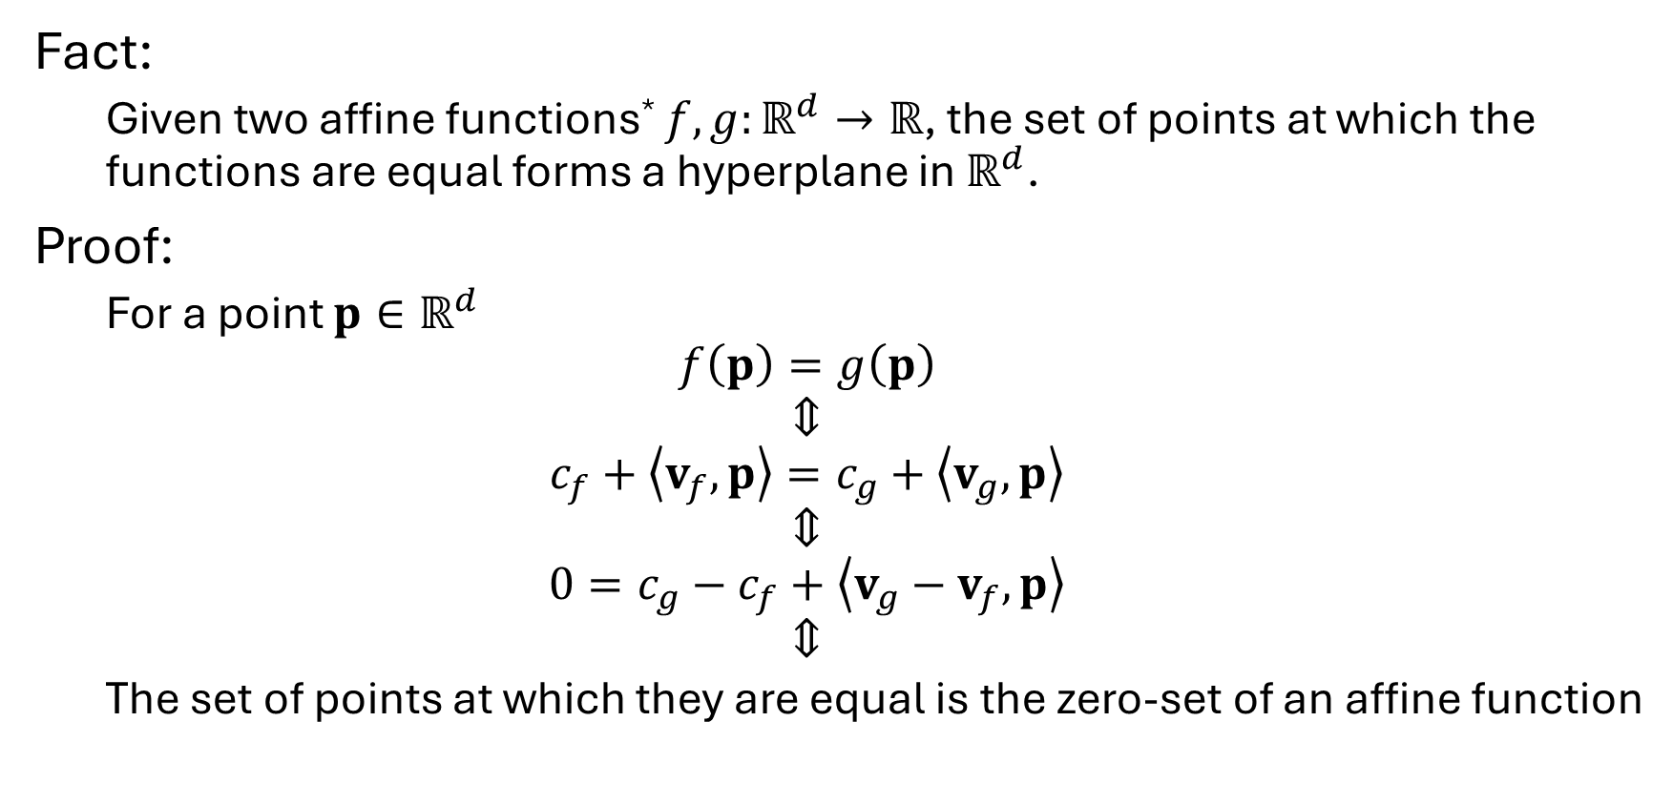
Review: affine functions in $ℝ^{d}$
Fact:
Given two affine functions* $f,g:ℝ^{d}→ℝ$, the set of points at which the functions are equal forms a hyperplane in $ℝ^{d}$.
Proof:
For a point $p∈ℝ^{d}$
$$f\left(p\right)=g\left(p\right)$$
$$⇕$$
$$c_{f}+\left\langle v_{f},p\right\rangle =c_{g}+\left\langle v_{g},p\right\rangle$$
$$⇕$$
$$0=c_{g}−c_{f}+\left\langle v_{g}−v_{f},p\right\rangle$$
$$⇕$$
The set of points at which they are equal is the zero-set of an affine function
*Throughout will be assuming that geometry is “in general position”

Slide 8
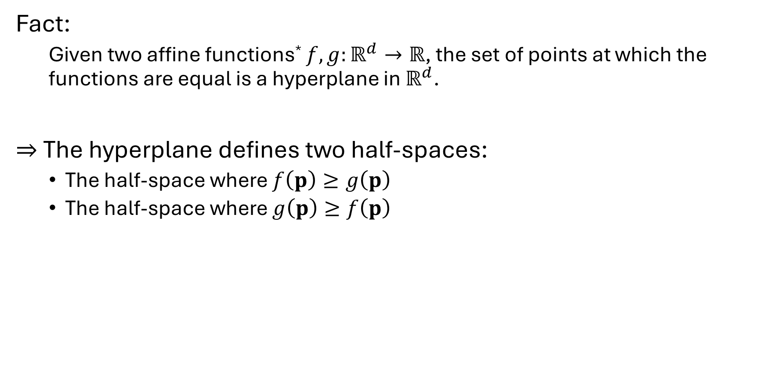
Review: affine functions in $ℝ^{d}$
Fact:
Given two affine functions* $f,g:ℝ^{d}→ℝ$, the set of points at which the functions are equal is a hyperplane in $ℝ^{d}$.
$⇒$ The hyperplane defines two half-spaces:
The half-space where $f\left(p\right)≥g\left(p\right)$
The half-space where $g\left(p\right)≥f\left(p\right)$
*Throughout will be assuming that geometry is “in general position”

Slide 9
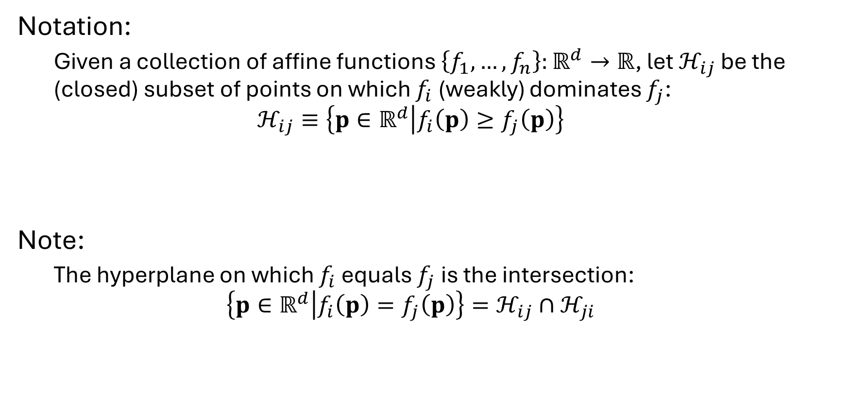
Review: affine functions in $ℝ^{d}$
Notation:
Given a collection of affine functions $\left\{f_{1},…, f_{n}\right\}:ℝ^{d}→ℝ$, let $ℋ_{ij}$ be the (closed) subset of points on which $f_{i}$ (weakly) dominates $f_{j}$:
$$ℋ_{ij}≡\left\{p∈ℝ^{d} | f_{i}\left(p\right)≥f_{j}\left(p\right)\right\}$$
Note:
The hyperplane on which $f_{i}$ equals $f_{j}$ is the intersection: $$\left\{p∈ℝ^{d} | f_{i}\left(p\right)=f_{j}\left(p\right)\right\}=ℋ_{ij}∩ℋ_{ji}$$

Slide 10
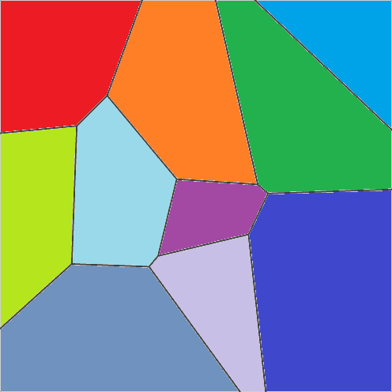








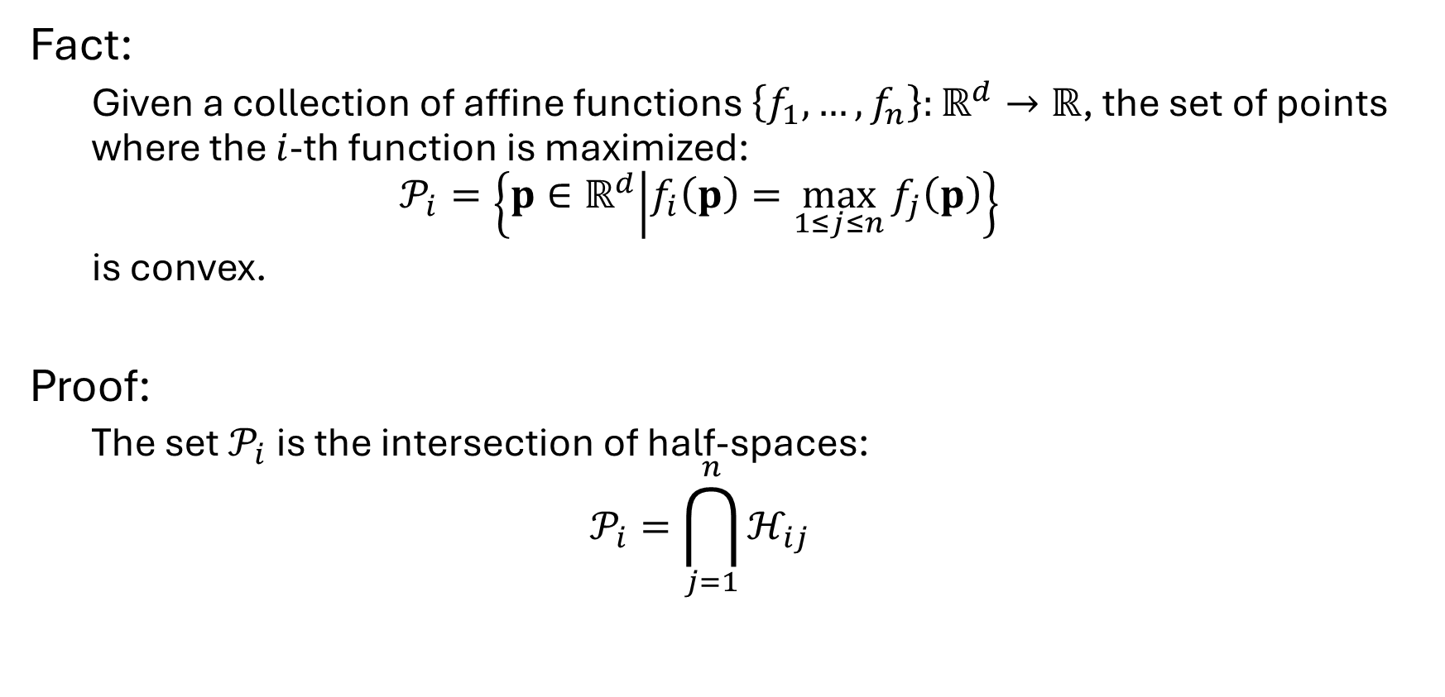


Review: affine functions in $ℝ^{d}$
Fact:
Given a collection of affine functions $\left\{f_{1},…, f_{n}\right\}:ℝ^{d}→ℝ$, the set of points where the $i$-th function is maximized:
$$𝒫_{i}=\left\{p∈ℝ^{d} | f_{i}\left(p\right)=\max_{1≤j≤n}{f_{j}\left(p\right)}\right\}$$ is convex.
Proof:
The set $𝒫_{i}$is the intersection of half-spaces: $$𝒫_{i}=\bigcap_{j=1}^{n}{ℋ_{ij}}$$
$$𝒫_{6}$$
$$𝒫_{9}$$
$$𝒫_{7}$$
$$𝒫_{8}$$
$$𝒫_{3}$$
$$𝒫_{4}$$
$$𝒫_{5}$$
$$𝒫_{1}$$
$$𝒫_{2}$$
$$𝒫_{0}$$

Slide 11
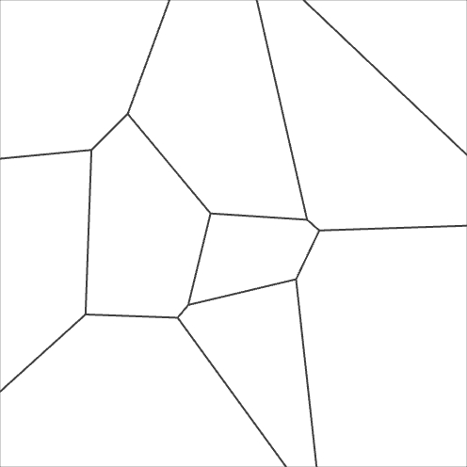


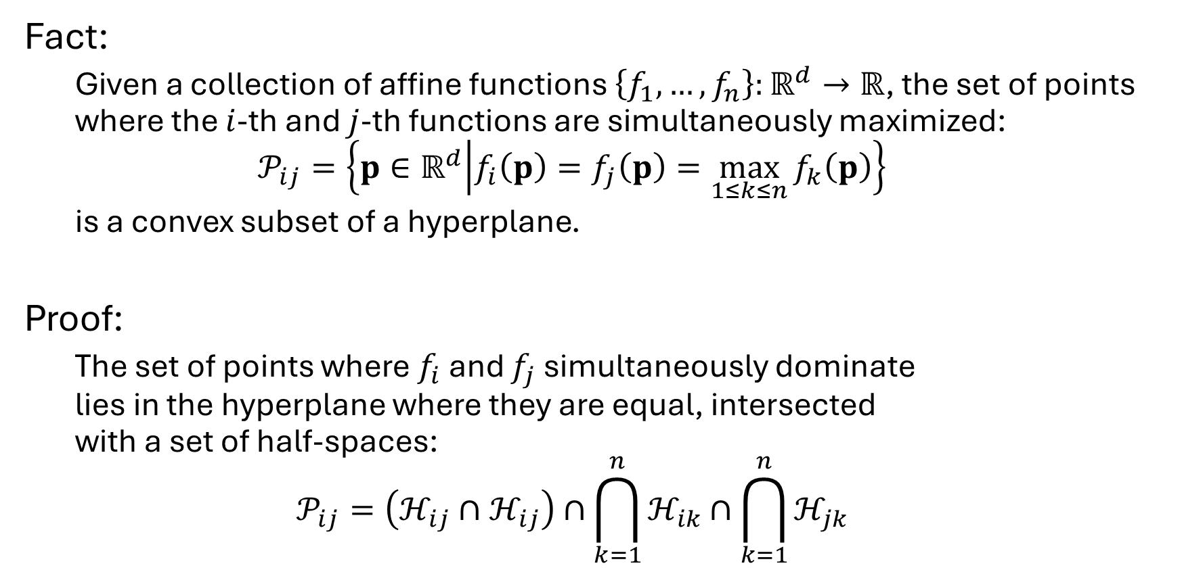
















Review: affine functions in $ℝ^{d}$
Fact:
Given a collection of affine functions $\left\{f_{1},…, f_{n}\right\}:ℝ^{d}→ℝ$, the set of points where the $i$-th and $j$-th functions are simultaneously maximized:
$$𝒫_{ij}=\left\{p∈ℝ^{d} | f_{i}\left(p\right)=f_{j}\left(p\right)=\max_{1≤k≤n}{f_{k}\left(p\right)}\right\}$$ is a convex subset of a hyperplane.
Proof:
The set of points where $f_{i}$ and $f_{j}$ simultaneously dominate lies in the hyperplane where they are equal, intersected with a set of half-spaces: $$𝒫_{ij}=\left(ℋ_{ij}∩ℋ_{ij}\right)∩\bigcap_{k=1}^{n}{ℋ_{ik}}∩\bigcap_{k=1}^{n}{ℋ_{jk}}$$
$$𝒫_{6}$$
$$𝒫_{67}$$
$$𝒫_{9}$$
$$𝒫_{89}$$
$$𝒫_{7}$$
$$𝒫_{78}$$
$$𝒫_{46}$$
$$𝒫_{8}$$
$$𝒫_{36}$$
$$𝒫_{47}$$
$$𝒫_{3}$$
$$𝒫_{57}$$
$$𝒫_{58}$$
$$𝒫_{28}$$
$$𝒫_{34}$$
$$𝒫_{4}$$
$$𝒫_{5}$$
$$𝒫_{45}$$
$$𝒫_{25}$$
$$𝒫_{04}$$
$$𝒫_{14}$$
$$𝒫_{15}$$
$$𝒫_{03}$$
$$𝒫_{1}$$
$$𝒫_{12}$$
$$𝒫_{2}$$
$$𝒫_{0}$$
$$𝒫_{01}$$

Slide 12
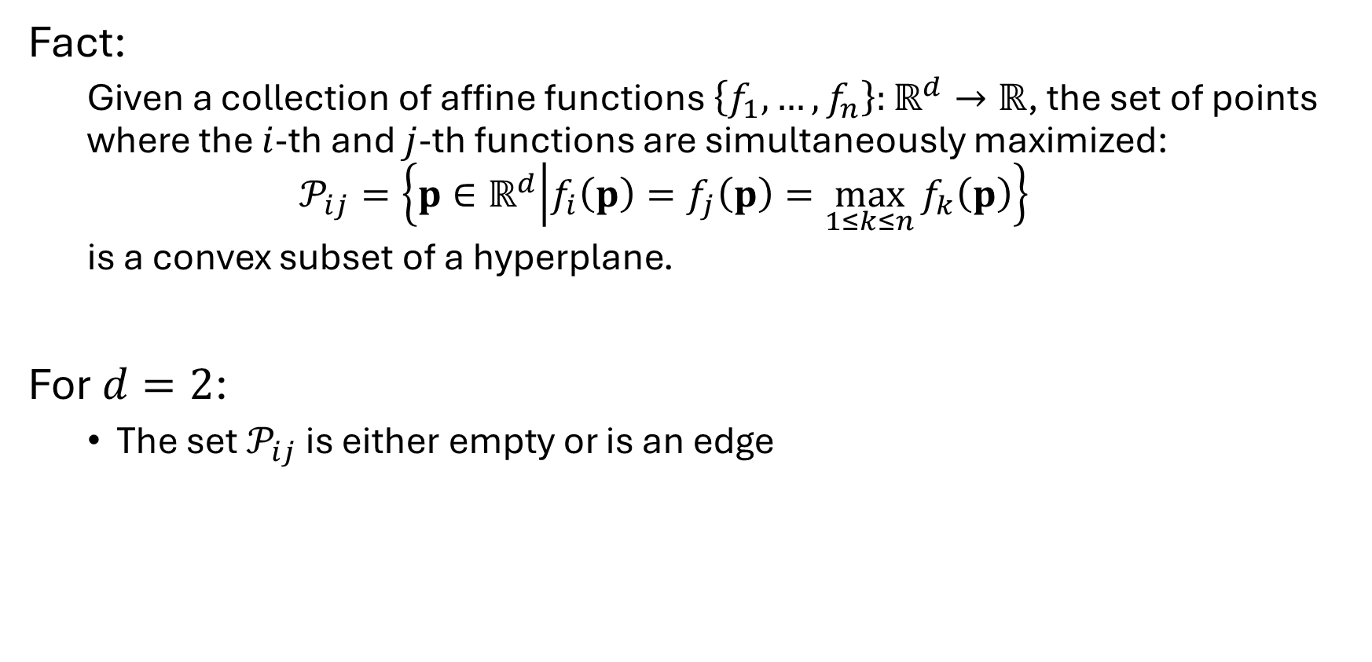
Review: affine functions in $ℝ^{d}$
Fact:
Given a collection of affine functions $\left\{f_{1},…, f_{n}\right\}:ℝ^{d}→ℝ$, the set of points where the $i$-th and $j$-th functions are simultaneously maximized:
$$𝒫_{ij}=\left\{p∈ℝ^{d} | f_{i}\left(p\right)=f_{j}\left(p\right)=\max_{1≤k≤n}{f_{k}\left(p\right)}\right\}$$ is a convex subset of a hyperplane.
For $d=2$:
The set $𝒫_{ij}$ is either empty or is an edge
$$𝒫_{6}$$
$$𝒫_{67}$$
$$𝒫_{9}$$
$$𝒫_{89}$$
$$𝒫_{7}$$
$$𝒫_{78}$$
$$𝒫_{46}$$
$$𝒫_{8}$$
$$𝒫_{36}$$
$$𝒫_{47}$$
$$𝒫_{3}$$
$$𝒫_{57}$$
$$𝒫_{58}$$
$$𝒫_{28}$$
$$𝒫_{34}$$
$$𝒫_{4}$$
$$𝒫_{5}$$
$$𝒫_{45}$$
$$𝒫_{25}$$
$$𝒫_{04}$$
$$𝒫_{14}$$
$$𝒫_{15}$$
$$𝒫_{03}$$
$$𝒫_{1}$$
$$𝒫_{12}$$
$$𝒫_{2}$$
$$𝒫_{0}$$
$$𝒫_{01}$$

Slide 13





Indicator functions
Given a solid shape $𝒮$, the indicator function: $$χ_{𝒮}:{\left[0,1\right]}^{2}→\{0,1\}$$
is the binary function:
Equal to $1$ inside the solid
Equal to $0$ outside the solid
$$1$$
$$0$$
$$χ_{S}:{\left[0,1\right]}^{2}→\{0,1\}$$

Slide 14
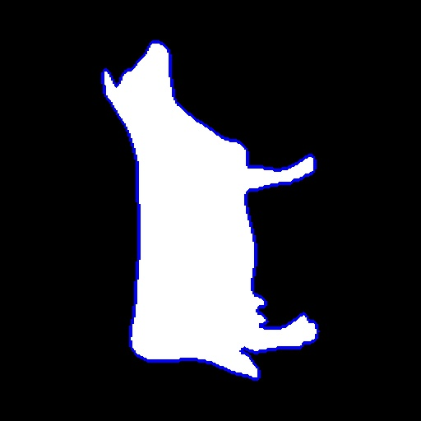
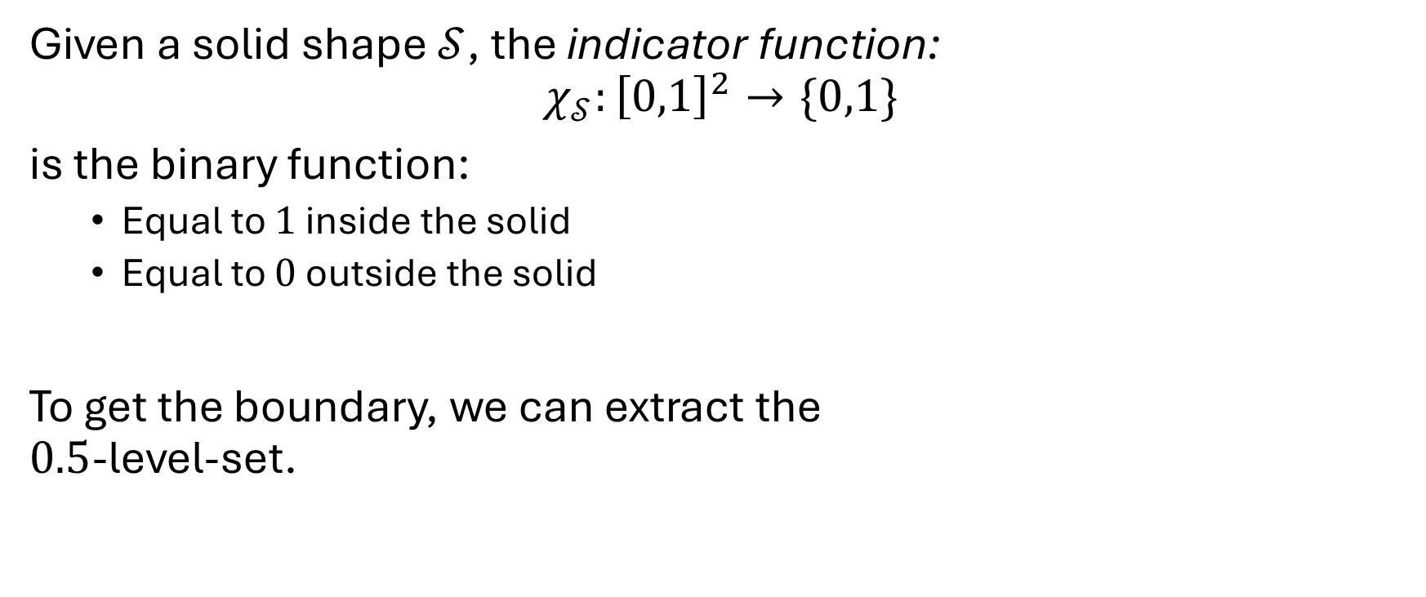
Indicator functions
Given a solid shape $𝒮$, the indicator function: $$χ_{𝒮}:{\left[0,1\right]}^{2}→\{0,1\}$$
is the binary function:
Equal to $1$ inside the solid
Equal to $0$ outside the solid
To get the boundary, we can extract the $0.5$-level-set.
$$1$$
$$0$$
$$χ_{S}:{\left[0,1\right]}^{2}→\{0,1\}$$

Slide 15



Smooth indicator functions
More generally, we can think of a soft assignment function: $$χ_{𝒮}:{\left[0,1\right]}^{2}→[0,1]$$
which has value:
Close to 1 at points that are likely to be inside
Close to $0$ at points that are likely to be outside
$$1$$
$$0$$
$$χ_{1}:{\left[0,1\right]}^{2}→[0,1]$$

Slide 16

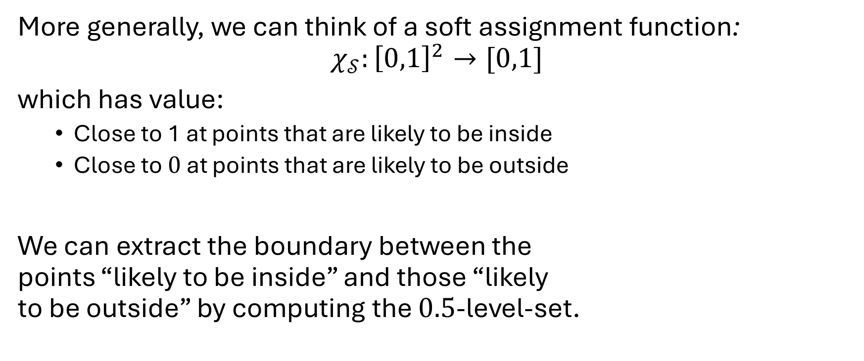
Smooth indicator functions
More generally, we can think of a soft assignment function: $$χ_{𝒮}:{\left[0,1\right]}^{2}→[0,1]$$
which has value:
Close to 1 at points that are likely to be inside
Close to $0$ at points that are likely to be outside
We can extract the boundary between the points “likely to be inside” and those “likely to be outside” by computing the $0.5$-level-set.
$$1$$
$$0$$
$$χ_{1}:{\left[0,1\right]}^{2}→[0,1]$$

Slide 17



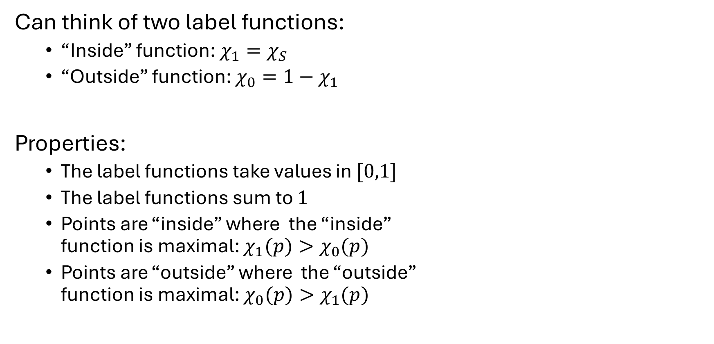

Smooth indicator functions
Can think of two label functions:
“Inside” function: $χ_{1}=χ_{S}$
“Outside” function: $χ_{0}=1−χ_{1}$
Properties:
The label functions take values in $[0,1]$
The label functions sum to $1$
Points are “inside” where the “inside” function is maximal: $χ_{1}(p)>χ_{0}(p)$
Points are “outside” where the “outside” function is maximal: $χ_{0}(p)>χ_{1}(p)$
$$1$$
$$χ_{0}:{\left[0,1\right]}^{2}→[0,1]$$
$$0$$
$$χ_{1}:{\left[0,1\right]}^{2}→[0,1]$$

Slide 18

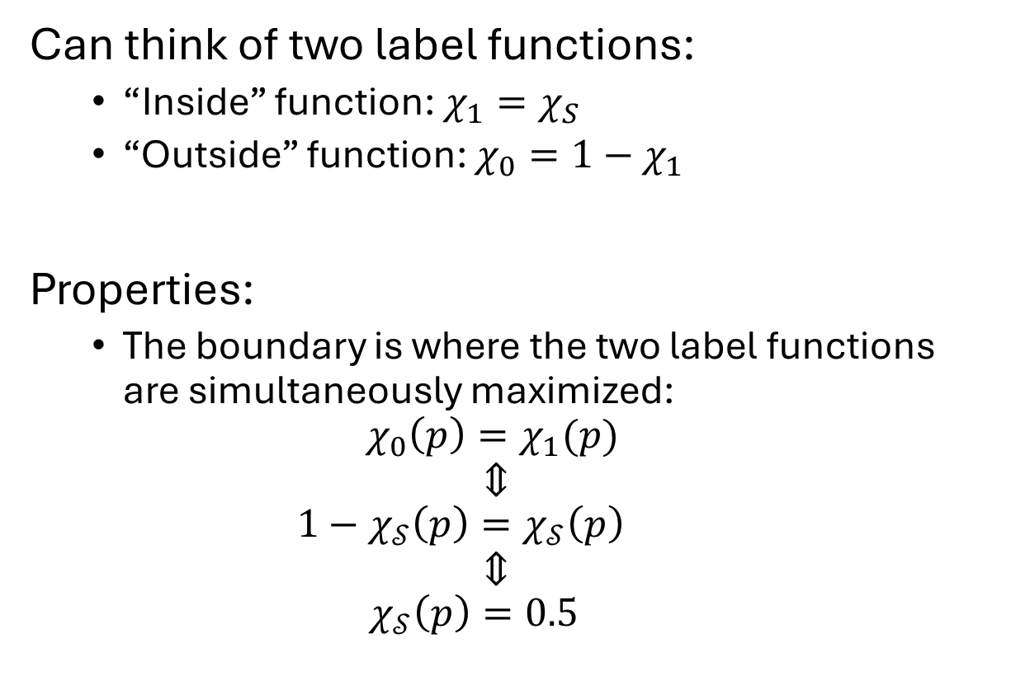
Smooth indicator functions
Can think of two label functions:
“Inside” function: $χ_{1}=χ_{S}$
“Outside” function: $χ_{0}=1−χ_{1}$
Properties:
The boundary is where the two label functions are simultaneously maximized:
$$χ_{0}\left(p\right)=χ_{1}(p)$$
$$⇕$$
$$1−χ_{𝒮}\left(p\right)=χ_{𝒮}\left(p\right)$$
$$⇕$$
$$χ_{𝒮}\left(p\right)=0.5$$
$$1$$
$$χ_{0}:{\left[0,1\right]}^{2}→[0,1]$$
$$0$$
$$χ_{1}:{\left[0,1\right]}^{2}→[0,1]$$

Slide 19
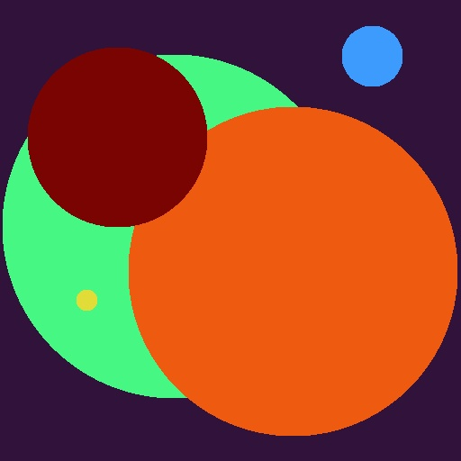

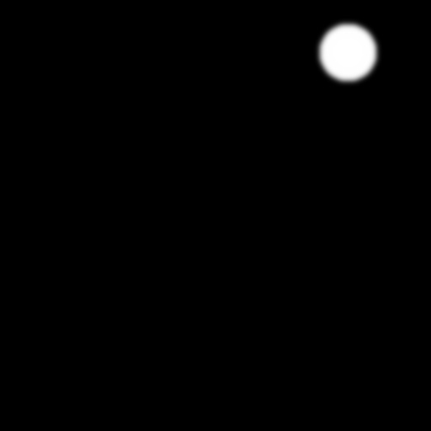

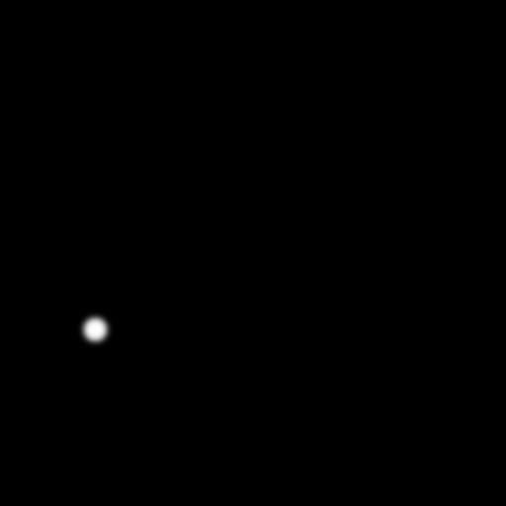









Generalization
What if we have more than two (soft) label functions?
We identify a label with the subset of points at which its function is maximized
$⇒$ For two labels $ℓ_{1}$ and $ℓ_{2}$, the $\left(ℓ_{1},ℓ_{2}\right)$ label boundary consist of the subset of points where:
The label functions of $ℓ_{1}$ and $ℓ_{2}$ are equal
The label functions of $ℓ_{1}$ and $ℓ_{2}$ are greater than (i.e. dominate) all other label
$$χ_{0}$$
$$χ_{1}$$
$$χ_{2}$$
$$χ_{3}$$
$$χ_{4}$$
$$χ_{5}$$

Slide 20

Generalization
Goal:
Given label functions $φ_{1},…,φ_{L}:{\left[0,1\right]}^{2}→\left[0,1\right]$forming a partition of unity, for every pair $1≤l<m≤L$, solve for the set of points: $$𝒫_{lm}=\left\{p∈{\left[0,1\right]}^{2}\right|φ_{l}\left(p\right)=φ_{m}\left(p\right)=\max_{1≤n≤L}{φ_{n}(p)}\}$$
$$χ_{0}$$
$$χ_{1}$$
$$χ_{2}$$
$$χ_{3}$$
$$χ_{4}$$
$$χ_{5}$$

Slide 21
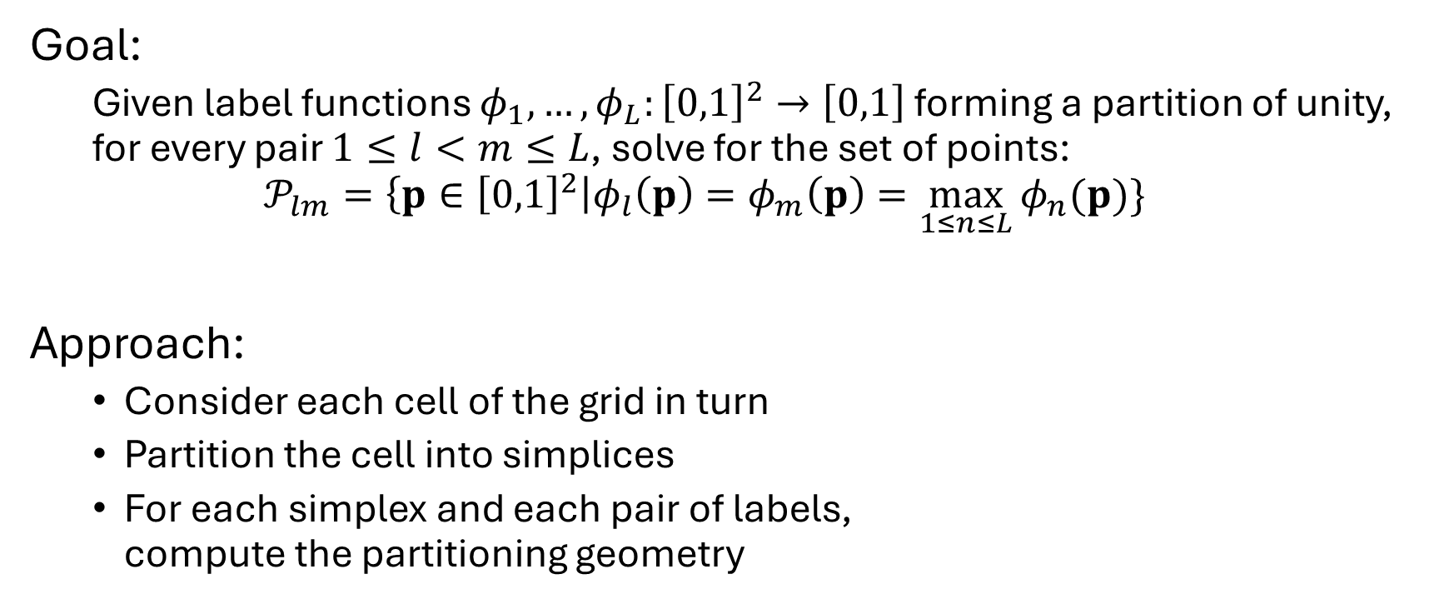
Generalization
Goal:
Given label functions $φ_{1},…,φ_{L}:{\left[0,1\right]}^{2}→\left[0,1\right]$forming a partition of unity, for every pair $1≤l<m≤L$, solve for the set of points: $$𝒫_{lm}=\left\{p∈{\left[0,1\right]}^{2}\right|φ_{l}\left(p\right)=φ_{m}\left(p\right)=\max_{1≤n≤L}{φ_{n}(p)}\}$$
Approach:
Consider each cell of the grid in turn
Partition the cell into simplices
For each simplex and each pair of labels, compute the partitioning geometry

Slide 22







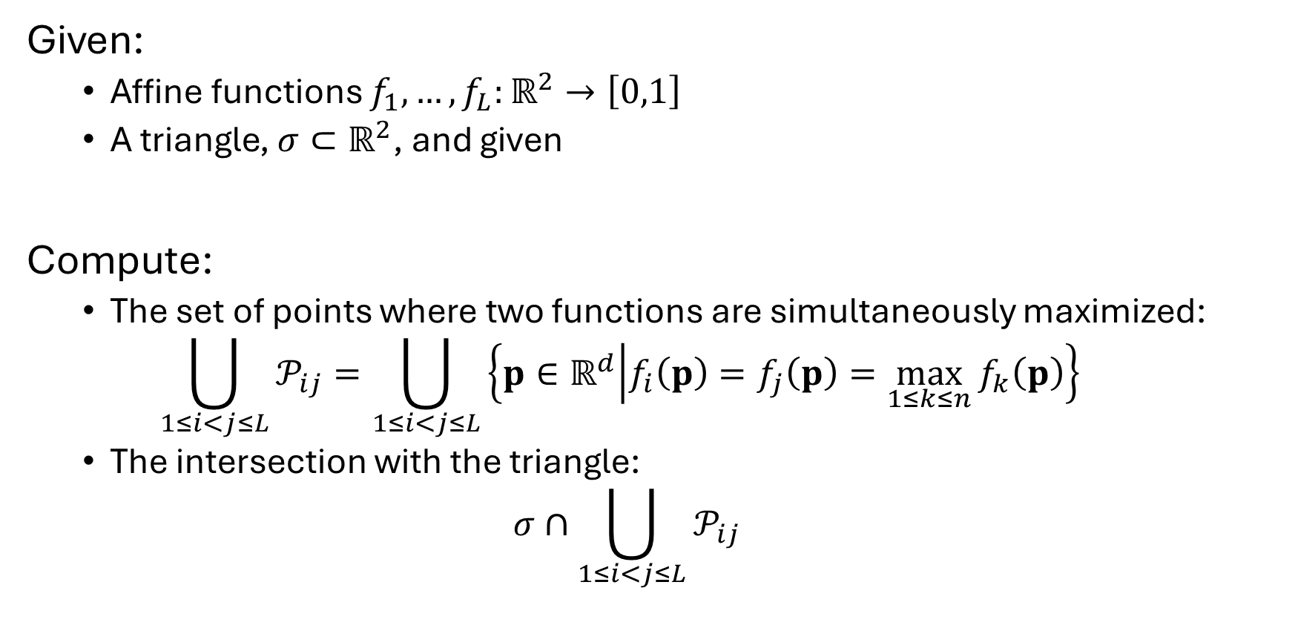











Approach: per simplex
$$𝒫_{67}$$
$$𝒫_{89}$$
$$𝒫_{46}$$
$$𝒫_{78}$$
$$𝒫_{36}$$
$$𝒫_{47}$$
$$𝒫_{57}$$
$$𝒫_{58}$$
$$𝒫_{28}$$
$$𝒫_{34}$$
$$𝒫_{25}$$
Given:
Affine functions $f_{1},…,f_{L}:ℝ^{2}→\left[0,1\right]$
A triangle, $σ⊂ℝ^{2}$, and given
Compute:
The set of points where two functions are simultaneously maximized: $\bigcup_{1≤i<j≤L}{𝒫_{ij}}=\bigcup_{1≤i<j≤L}{\left\{p∈ℝ^{d} | f_{i}\left(p\right)=f_{j}\left(p\right)=\max_{1≤k≤n}{f_{k}\left(p\right)}\right\} }$
The intersection with the triangle: $σ∩\bigcup_{1≤i<j≤L}{𝒫_{ij}}$
$$𝒫_{45}$$
$$𝒫_{04}$$
$$𝒫_{14}$$
$$𝒫_{15}$$
$$𝒫_{03}$$
$$𝒫_{12}$$
$$𝒫_{01}$$

Slide 23
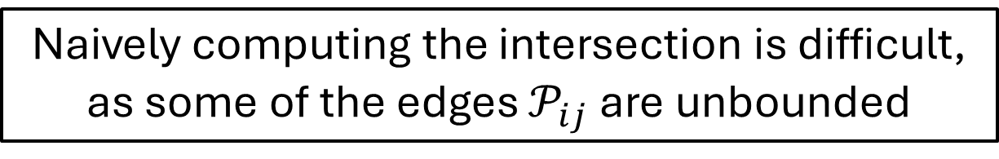
Approach: per simplex
$$𝒫_{67}$$
$$𝒫_{89}$$
$$𝒫_{46}$$
$$𝒫_{78}$$
$$𝒫_{36}$$
$$𝒫_{47}$$
$$𝒫_{57}$$
$$𝒫_{58}$$
$$𝒫_{28}$$
$$𝒫_{34}$$
$$𝒫_{25}$$
Given:
Affine functions $f_{1},…,f_{L}:ℝ^{2}→\left[0,1\right]$
A triangle, $σ⊂ℝ^{2}$, and given
Compute:
The set of points where two functions are simultaneously maximized: $\bigcup_{1≤i<j≤L}{𝒫_{ij}}=\bigcup_{1≤i<j≤L}{\left\{p∈ℝ^{d} | f_{i}\left(p\right)=f_{j}\left(p\right)=\max_{1≤k≤n}{f_{k}\left(p\right)}\right\} }$
The intersection with the triangle: $σ∩\bigcup_{1≤i<j≤L}{𝒫_{ij}}$
$$𝒫_{45}$$
$$𝒫_{04}$$
$$𝒫_{14}$$
$$𝒫_{15}$$
$$𝒫_{03}$$
$$𝒫_{12}$$
$$𝒫_{01}$$
Naively computing the intersection is difficult, as some of the edges $𝒫_{ij}$ are unbounded

Slide 24





























Observation
$$𝒫_{6}$$
$$𝒫_{9}$$
$$𝒫_{7}$$
$$𝒫_{8}$$
$$𝒫_{3}$$
$$𝒫_{4}$$
$$𝒫_{5}$$
We are interested in two types of vertices:
The vertices interior to the triangle (red)
$⇒$ Points where three functions are equal and dominate
The vertices on the boundary of the triangle (blue)
$⇒$ Points where two functions are equal and dominate
Note:
Since $𝒫_{ij}$ is either empty or an edge, and since the triangle $σ$ is convex, the intersection $𝒫_{ij}∩σ$ is either empty or an edge
$$𝒫_{1}$$
$$𝒫_{2}$$
$$𝒫_{0}$$
$$𝒫_{67}$$
$$𝒫_{89}$$
$$𝒫_{46}$$
$$𝒫_{78}$$
$$𝒫_{36}$$
$$𝒫_{47}$$
$$𝒫_{57}$$
$$𝒫_{58}$$
$$𝒫_{28}$$
$$𝒫_{34}$$
$$𝒫_{45}$$
$$𝒫_{25}$$
$$𝒫_{04}$$
$$𝒫_{14}$$
$$𝒫_{15}$$
$$𝒫_{03}$$
$$𝒫_{12}$$
$$𝒫_{01}$$

Slide 25















Algorithm
$$𝒫_{6}$$
$$𝒫_{9}$$
$$𝒫_{7}$$
$$𝒫_{8}$$
$$𝒫_{3}$$
$$𝒫_{4}$$
$$𝒫_{5}$$
// Get triangle vertices
For each triplet $1≤i<j<k≤L$
Compute the point $p$ s.t. $f_{i}\left(p\right)=f_{j}\left(p\right)=f_{k}(p)$
If $p$ is in the triangle and $f_{i}\left(p\right)=f_{j}\left(p\right)=f_{k}(p)=\max{f_{l}(p)}$
Add $p$, annotated with $(i,j,k)$ to the vert list
// Get edge vertices
For each boundary edge of $σ$:
For each pair $1≤i<j≤L$
Compute the point $p$ s.t. $f_{i}\left(p\right)=f_{j}(p)$
If $p$ is on the edge and $f_{i}\left(p\right)=f_{j}\left(p\right)=\max{f_{k}(p)}$
Add $p$, annotated with $(i,j)$ to the vert list
$$𝒫_{1}$$
$$𝒫_{2}$$
$$𝒫_{0}$$
$$(8,9)$$
$$(8,9)$$
$$(7,8)$$
$$(4,7)$$
$$(5,7,8)$$
$$(4,5,7)$$
$$(2,5,8)$$
$$(2,8)$$
$$(0,4)$$
$$(1,4,5)$$
$$(1,2,5)$$
$$(0,1,4)$$
$$(0,1)$$
$$(1,2)$$

Slide 26

Algorithm
$$𝒫_{6}$$
$$𝒫_{9}$$
$$𝒫_{7}$$
$$𝒫_{8}$$
$$𝒫_{3}$$
$$𝒫_{4}$$
$$𝒫_{5}$$
// Get edges
For each pair $1≤i<j≤L$
Combine vertices in the triangle/edge vert list which are annotated with both $i$ and $j$ into an edge
$$𝒫_{1}$$
$$𝒫_{2}$$
$$𝒫_{0}$$
$$(8,9)$$
$$(8,9)$$
$$(7,8)$$
$$(4,7)$$
$$(5,7,8)$$
$$(4,5,7)$$
$$(2,5,8)$$
$$(2,8)$$
$$(0,4)$$
$$(1,4,5)$$
$$(1,2,5)$$
$$(0,1,4)$$
$$(0,1)$$
$$(1,2)$$

Slide 27
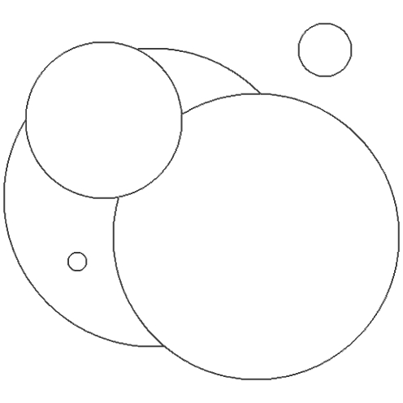
Motivation
Multi-label segmentation

Slide 28

Motivation
Question:
Why not individually separate each label from the combination (e.g. sum) of the other labels?
Individual label segmentation
Multi-label segmentation

Slide 29
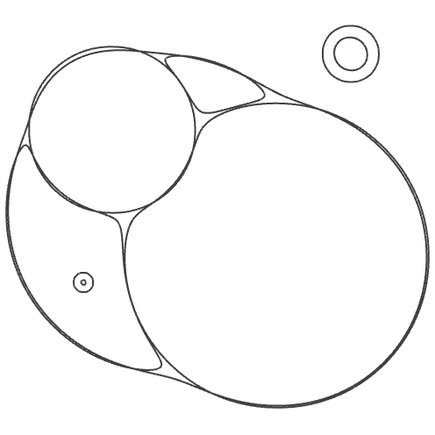
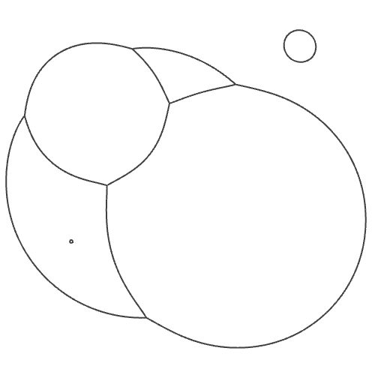
Motivation
Question:
Why not individually separate each label from the combination (e.g. sum) of the other labels?
Answer:
Individually segmenting does not partition space.
This becomes apparent if we smooth the curves
Individual label segmentation (smoothed)
Multi-label segmentation (smoothed)

Slide 30
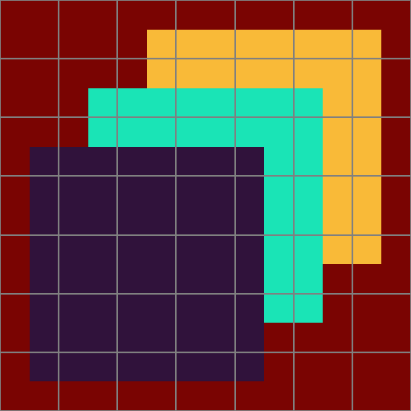

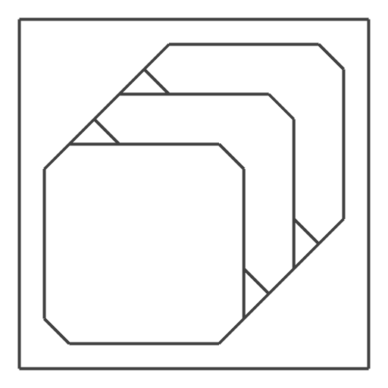

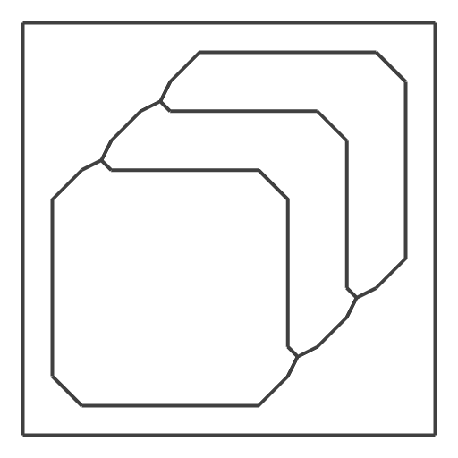
Motivation
Question:
Why not individually separate each label from the combination (e.g. sum) of the other labels?
Answer:
Individually segmenting does not partition space.
This becomes apparent if we smooth the curves
But is also evident at coarse resolutions
Individual label segmentation
Multi-label segmentation (smoothed)

Slide 31
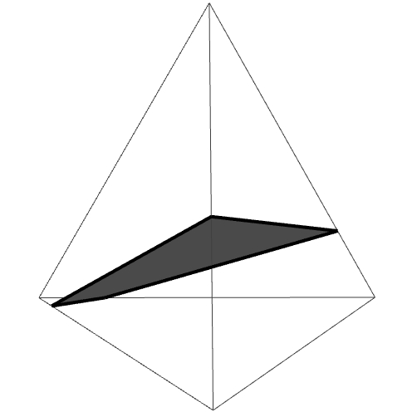
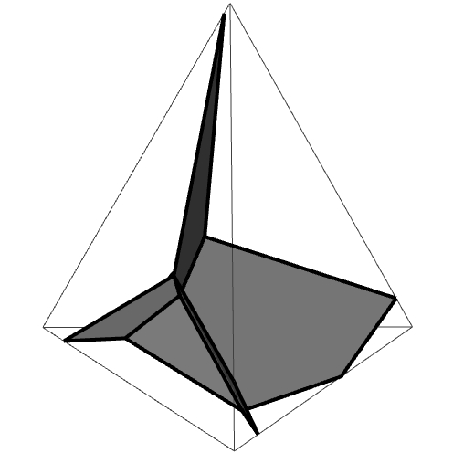
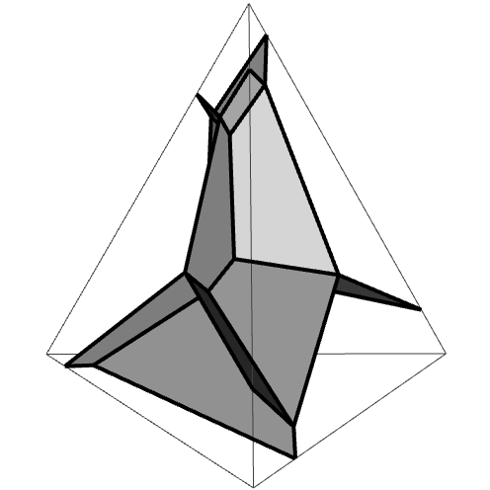
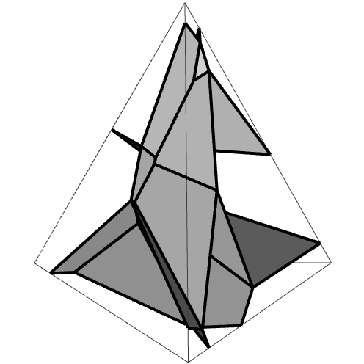
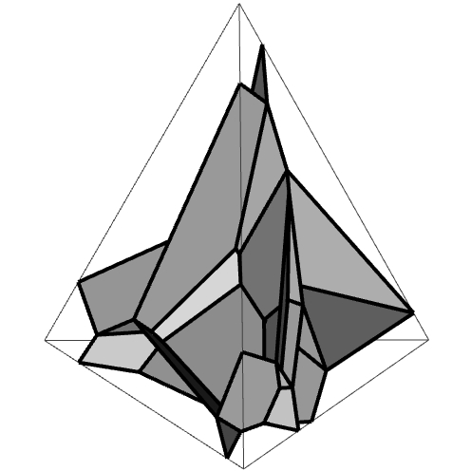
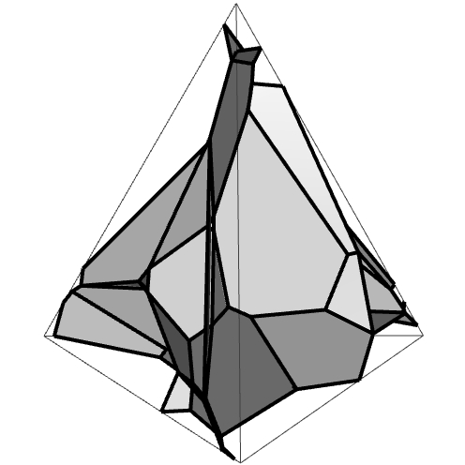







Extensions to higher dimensions
For $d$-dimensional simplices:
Need to compute annotated vertices on all $d′$-dimensional sub-simplices, with $1≤d^{′}≤d$, by computing the position at which $d^{′}+1$ affine functions dominate.
$𝒫_{ij}$ is a convex polytope in a $(d−1)$-dimensional hyperplane
$⇒$ Compute the convex hull of all vertices annotated with both $i$ and $j$.
$$L=2$$
$$L=4$$
$$L=8$$
$$L=16$$
$$L=32$$
$$L=64$$

